Slide 1


Advanced Angular
www.angulartraining.com
Notes:
Link to these slides: https://bit.ly/at-advanced

Slide 2
How we’re going to work
Your questions are welcome, anytime!
Angular evolves very fast, which is the new norm for web development
Being a web developer requires constant learning
My goal is to give you the tools to work efficiently with Angular - We’re going to practice a lot!
As a result, we will be going through the online documentation very often
Notes:
This book contains all of the slides content plus additional notes at the bottom. This text is an additional note :-)
Don’t hesitate to use that space for your own notes too.
This content can be found and downloaded at: http://goo.gl/sh6rCP
All of the the source code for the labs can be downloaded at: https://github.com/alcfeoh/ng2-training

Slide 3
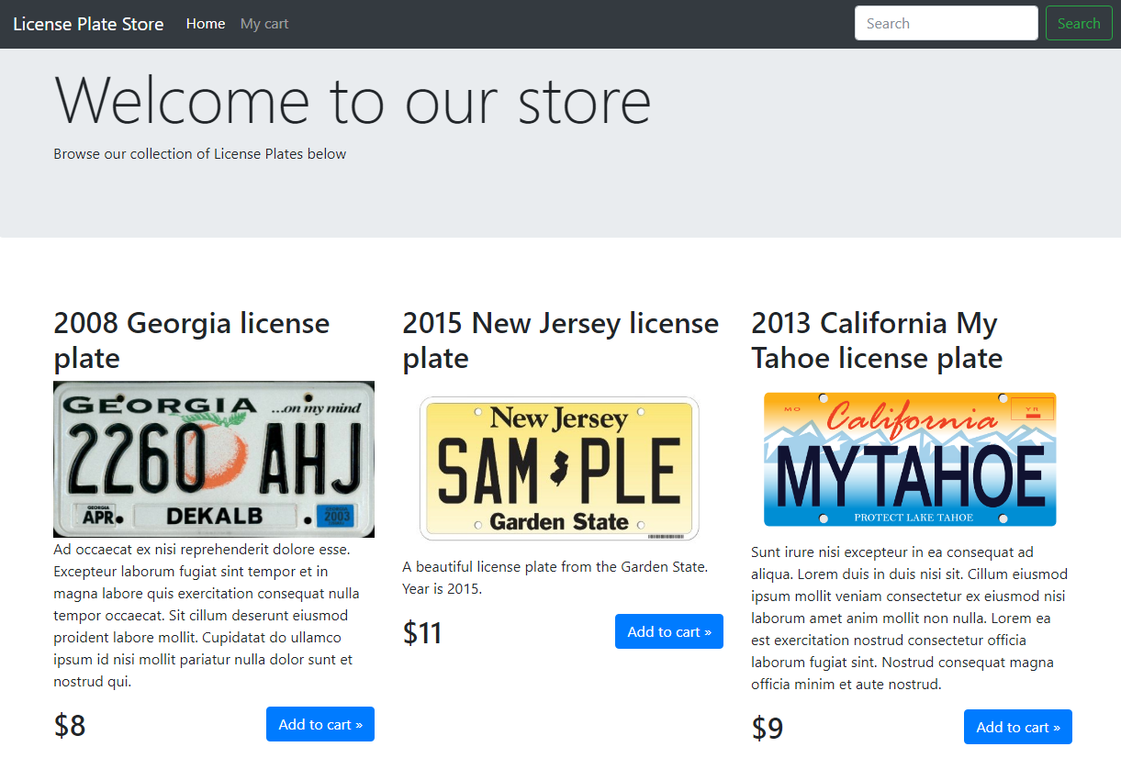
We are going to build a full application
Notes:
This book contains all of the slides content plus additional notes at the bottom. This text is an additional note :-)
Don’t hesitate to use that space for your own notes too.
This content can be found and downloaded at: http://goo.gl/sh6rCP
All of the the source code for the labs can be downloaded at: https://github.com/alcfeoh/ng2-training

Slide 4
Quick poll
How many of you are Java developers? C#, .Net?
How much experience do you have with Angular?
With Javascript? TypeScript?
jQuery?
Another Javascript framework? React, Backbone?

Slide 5
Chapter 1:
Angular Essentials
Release schedule
Environment set-up
Working with different environments
Angular CLI
www.angulartraining.com

Slide 6

A bit of Angular history
Angular JS era (1.x)
Angular era (2+)
2012
2013
2014
2015
2016
2017
2018
2019
1.0
1.2
1.3
1.4
1.5
2.0
4.0
5.0
6.0
7.0
8.0
1.1
Releases happen from time to time
Clear, predictable schedule
Notes:
This book contains all of the slides content plus additional notes at the bottom. This text is an additional note :-)
Don’t hesitate to use that space for your own notes too.
This content can be found and downloaded at: http://goo.gl/sh6rCP
All of the the source code for the labs can be downloaded at: https://github.com/alcfeoh/ng2-training

Slide 7
Semantic versioning and schedule
Angular adopted semantic versioning
Major versions are released every 6 months - supported for 18 months
Minor versions happen once a month
Patch versions happen every week if needed
X . Y . Z
Major version - Minor version - Patch release
Notes:
This book contains all of the slides content plus additional notes at the bottom. This text is an additional note :-)
Don’t hesitate to use that space for your own notes too.
This content can be found and downloaded at: http://goo.gl/sh6rCP
All of the the source code for the labs can be downloaded at: https://github.com/alcfeoh/ng2-training

Slide 8
Angular CLI - https://cli.angular.io/
It’s a code generator
It’s a set of tools for development (local server, auto-refresh)
It’s a set of build tools (compile, lint, minify...)
Also very helpful for testing
Notes:
This book contains all of the slides content plus additional notes at the bottom. This text is an additional note :-)
Don’t hesitate to use that space for your own notes too.
This content can be found and downloaded at: http://goo.gl/sh6rCP
All of the the source code for the labs can be downloaded at: https://github.com/alcfeoh/ng2-training

Slide 9
Angular CLI helps with structure
Angular is complex, has many dependencies and requires a lot of set-up
As a result, the Angular team decided to provide a command line tool called Angular CLI http://cli.angular.io
This tool creates the entire structure of your project by following the best practices from the Angular team (folder structure, file names, etc.)
It also allows you to generate new Components, Pipes and so forth from simple commands
Notes:
This book contains all of the slides content plus additional notes at the bottom. This text is an additional note :-)
Don’t hesitate to use that space for your own notes too.
This content can be found and downloaded at: http://goo.gl/sh6rCP
All of the the source code for the labs can be downloaded at: https://github.com/alcfeoh/ng2-training

Slide 10
Angular CLI and environments
Angular CLI allows you to define different configurations (Prod, Dev, QA, etc.) in angular.json:
"configurations": {
"production": {
…
"buildOptimizer": true,
"fileReplacements": [ {"replace": "src/environments/environment.ts",
"with": "src/environments/environment.prod.ts"} ]
}
Then if you want to serve (or build or test) you project with that environment:
ng serve --configuration=production
Notes:
This book contains all of the slides content plus additional notes at the bottom. This text is an additional note :-)
Don’t hesitate to use that space for your own notes too.
This content can be found and downloaded at: http://goo.gl/sh6rCP
All of the the source code for the labs can be downloaded at: https://github.com/alcfeoh/ng2-training

Slide 11
Angular CLI: ng generate and schematics
Schematics are what Angular uses under the hood when we use ng generate to create a new component, service, etc.
It is possible to create our own schematics or even to update existing ones
Many Angular libraries now provide their own set of schematics. For instance, Angular Material:
ng generate @angular/material:material-table --name <component-name>

Slide 12
Angular CLI: ng update
When updating Angular, it is recommended to use the guide at: https://update.angular.io/
Starting with Angular 6 (and Angular CLI 6), we can now use ng update to automate most of the process:
ng update @angular/cli
ng update @angular/core
ng update @angular/material

Slide 13
Angular CLI: ng add
Starting with Angular 6 (and Angular CLI 6), you can now use ng add to automatically add some packages to your projects.
Some examples:
ng add @angular/material
ng add @ng-bootstrap/schematics

Slide 14

Lab #0: Dev environment set-up
Go to our labs folder ng2-training-master
Run ng serve to compile the code and start a local server on your machine
Open http://localhost:4200 in your browser
We use Angular CLI (https://cli.angular.io/) to build & serve our code

Slide 15
Chapter 2:
Components
What are components?
Template and expressions
Practicing with Angular CLI
Best practices on component architecture and design
www.angulartraining.com

Slide 16
What are components?
A component is comparable to an HTML element that YOU create
It controls a small part of the screen
An Angular app is a tree of components:
<my-app>
<header title=”A title”></header>
<left-menu [items]=”items”></left-menu>
<data-view [hidden]=false></data-view>
</my-app>

Slide 17
Angular component: HTML and CSS
Both HTML and CSS for a component can be stored in their own files
We get those files loaded using the following syntax:
@Component({
selector: 'app-hello',
templateUrl: './hello.component.html',
styleUrls: ['./hello.component.css']
})
export class HelloComponent {
//

Slide 18
How to generate Angular code?
Set-up of an Angular app is complex
Angular CLI is here to help, for instance:
ng generate component Dashboard
Also a shorter version: ng g c Dashboard
Reference documentation can be found here: https://cli.angular.io/reference.pdf

Slide 19
Passing data to a component
Since a component is an HTML element, we can pass data to it using HTML properties:
<app-popup-window title="Test pop-up">
@Input() is a decorator that, when applied to a component property, makes the above possible - we can now set the value of title from our HTML code:
@Input()
title: string;

Slide 20
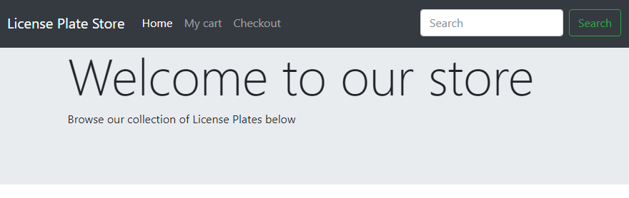
Lab C2 - Creating components
Our goal for this lab is to build two components, navigation and jumbotron to make our user interface look exactly like this:
Navigation
Jumbotron
Notes:
No worries, the HTML templates and CSS are provided!
We’re using Bootstrap for CSS styling, a UI library from Twitter: http://getbootstrap.com/

Slide 21
Lab #2 - Creating components
Update app.component.ts to make it use app.component.html as a template
Use Angular CLI to generate a navigation component
Change the template for that new component. Use the template provided in: lab-templates/navigation
Use our new app-navigation component selector in app.component.html where instructed in that file.
Congrats, you just created your first component!

Slide 22
Lab C2 - Creating components
Update the jumbotron component
Use the app-jumbotron component selector in app.component.html where instructed in that file.
jumbotron will be used in different contexts in our application (cart page, checkout page) so we need to add two properties title and description that can be set with @Input to make that component configurable.

Slide 23
Component architecture and design
Angular embraces reactive programming, where components now how to react to external changes
This pattern relies on two types of components:
Container components (or “smart” components) know how to get data and work with services
Presentation components (a.k.a. “dumb” or “lazy” components) have to be fed with data using @Input

Slide 24
Component Architecture: Recap
Services
Container
component
App
Component
Data
@Input
@Input
Navigation
component
Jumbotron component
Presentation
components

Slide 25
Chapter 3:
Data bindings
One-way data bindings
Expressions
Two-way data bindings with ngModel
Template syntax
www.angulartraining.com

Slide 26
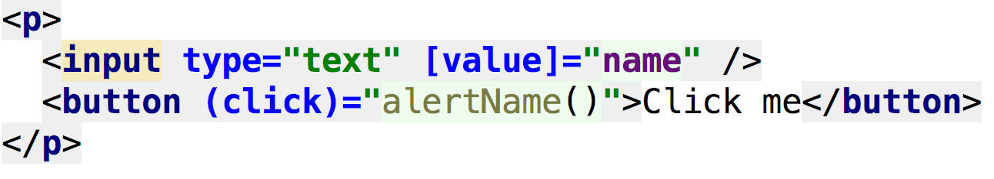
Angular Data Bindings - [] and ()
Component class properties can be bound to HTML attributes:
The above sets the value of the value HTML attribute of the input element to this.name in our component class
It also binds the onClick event to the alertName() method

Slide 27

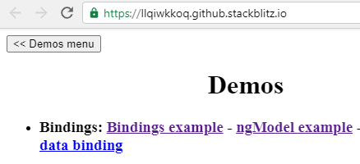
Angular Data Bindings
In order to see a demo of that code in action, go to:
http://bit.ly/ng-training-demos
Demos are using Stackblitz, an online IDE that can also compile and serve Angular projects
Then click on the Bindings example link
Notes:
The source code for that specific example is in /src/app/bindings (https://stackblitz.com/github/alcfeoh/ng-training-demos?file=src%2Fapp%2Fbindings%2Fbindings.component.html)
All slides with demos have a blue icon in the top right corner so you know that there is an example for this concept in the demos Stackblitz project.

Slide 28
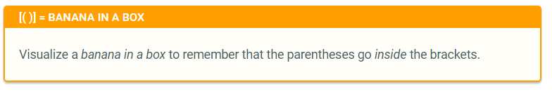
Angular Models - [(ngModel)]
[(ngModel)] = 2-way data binding
Changes to the HTML update your TS scope and vice-versa:

Slide 29
Bindings + HTML = Super Powers
Since bindings work on any HTML attribute, you can use then to apply styles conditionally:
<p [style.color]="hasError ? 'red' : 'blue'">
This also works to show/hide error messages:
<div [hidden]="noErrors">
The value you entered is not valid
</div>

Slide 30
Lab DB1 - Bindings
In this lab, we are going to use a LicensePlate component to render a product of our store. Take a look at its code.
Add a LicensePlate component to the HTML template of our AppComponent (there is a HTML comment in the HTML to tell you where to put it)
Use the data model provided in app.component.ts to bind it to the plate @Input of the LicensePlate

Slide 31
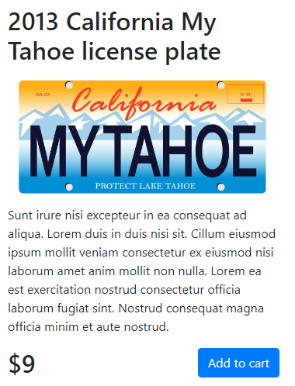
Lab DB1 - Bindings
Update some more code to make the license plate render as follows:
Make sure that the button has the text “Add to cart”, and that the actual price of the plate gets rendered
When the button is clicked, alert a message: “Plate added to cart”

Slide 32
Bindings + HTML = Super Powers
You can make a template expression null-safe using the “Elvis” operator:
<div>The person name is: {{person?.firstName}}</div>
The above code will display an empty string instead of an error if person is undefined

Slide 33
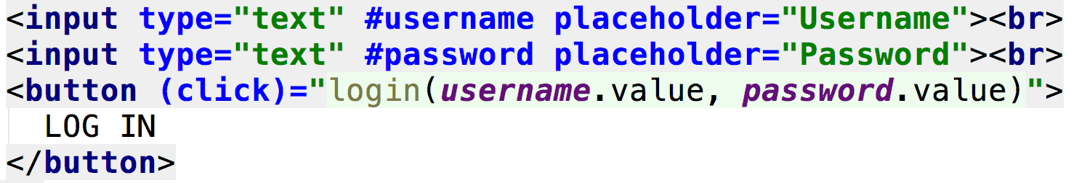
Template reference variables
An easy way to access some dom values without writing a directive nor using data bindings
Hashtag syntax:

Slide 34
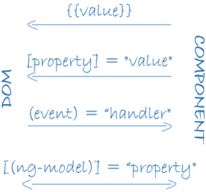
Bindings - Recap
Expressions {{}} and property bindings with [] are one-way data bindings
Event bindings with () are one-way data bindings
[(ngModel)] works both ways

Slide 35
Chapter 4:
Directives
What are directives for?
Different kinds of directives
ngFor, ngIf, ngSwitch, ngClass, ngStyle
How to create a custom directive?
www.angulartraining.com

Slide 36
Angular Directives
Directives allow DOM manipulation
There are three kinds of Angular directives:
- Components = Directives with a HTML template
- Attribute directives = Change attribute values (ngModel)
- Structural directives = Change the HTML structure

Slide 37
Angular *ngFor
*ngFor is a structural directive
Equivalent of Angular JS ng-repeat
A loop to iterate through data model items:
<li *ngFor="let person of persons">
{{ getDisplayName(person) }}
</li>

Slide 38
Lab DC1 - ngFor
Use the *ngFor directive to render all of the license plates from AppComponent, stored in the licensePlates property.
Using the documentation at angular.io, figure out a way to render every other plate with a light grey background (HTML color code #F5F5F5)
See next page for a better idea of what the end result should look like

Slide 39
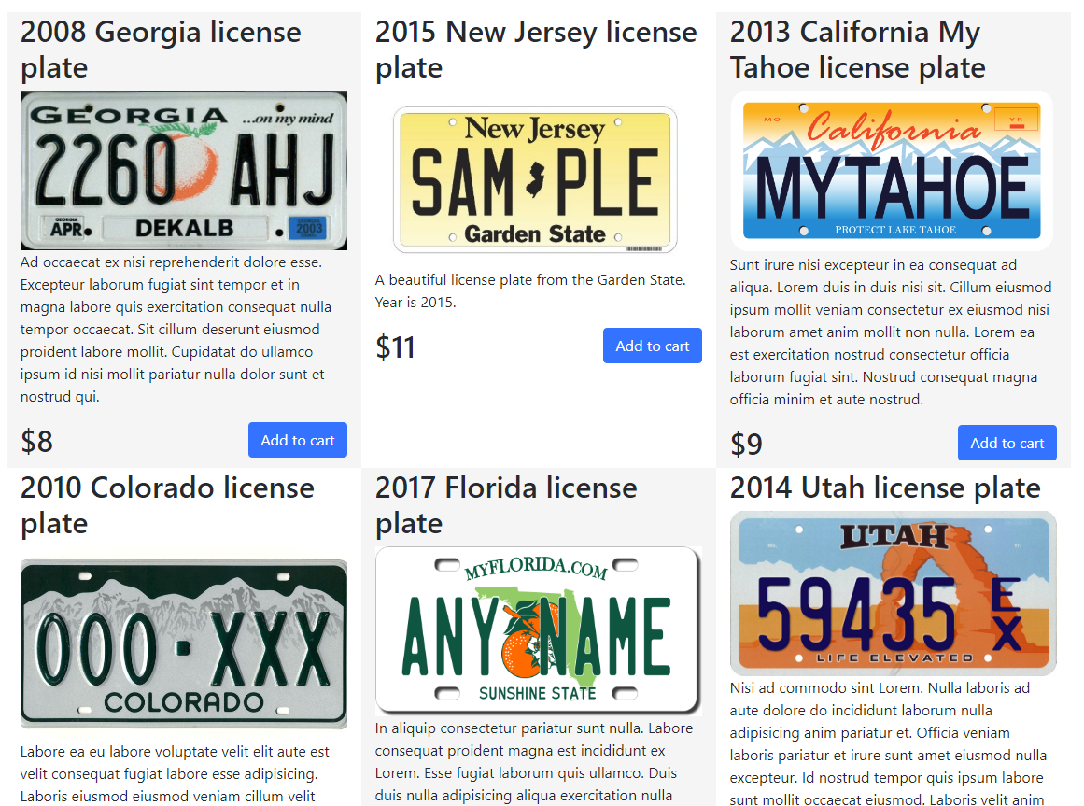
Lab DC1 - ngFor

Slide 40
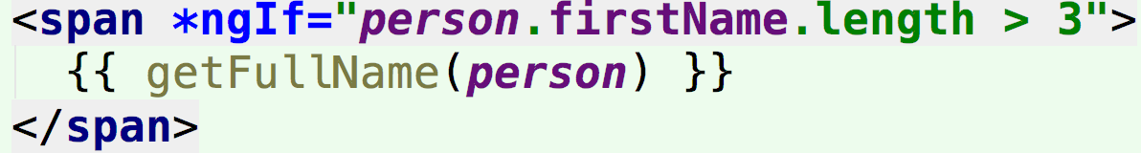
Angular *ngIf
Directives like Angular JS ng-show, ng-hide are replaced by HTML attribute bindings
For instance, [hidden]=”myCondition”
*ngIf is based on DOM rather than CSS:

Slide 41
Angular *ngIf - with else
It is also possible to have another template to render if the condition is not met:
<div *ngIf="isValid; else other_content">
content here ...
</div>
<ng-template #other_content>
other content here…
</ng-template>

Slide 42
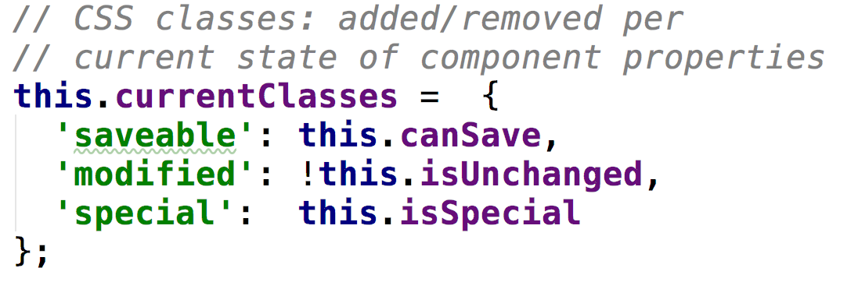
ngClass directive
While we can bind expressions to both style and class HTML attributes, ngClass allows us to apply multiple styles conditionally

Slide 43
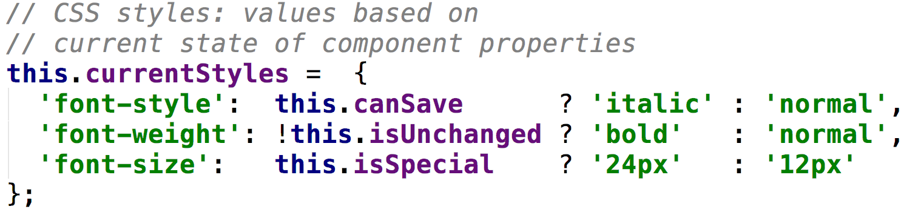
ngStyle directive
ngStyle is similar to ngClass. It allows us to tweak several style properties conditionally.

Slide 44
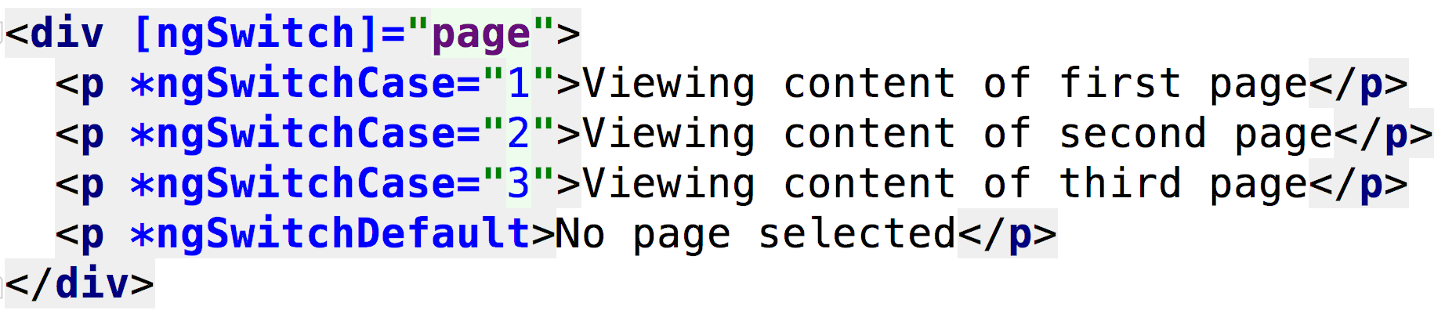
Angular ngSwitch
Switch-case implementation for Angular
Allows to display content conditionally:

Slide 45
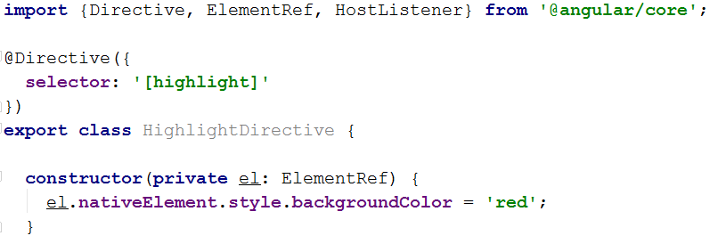
How to create a custom directive?
A directive is a class with an annotation
We can inject a reference to the DOM element it is applied to, along with a renderer object:

Slide 46
Data bindings in directives
Directives don’t have any HTML template so we cannot use [] or () to create data bindings.
That’s why there are two specific decorators to do that:
@HostBinding('style.color')
color = 'red';
@HostListener('click')
onClick() {
// Do something on click
}

Slide 47
Data bindings in directives
Another option to create data bindings in directives is to use the host property in the @Directive decorator as shown below:
@Directive({
selector: '[countClicks]',
host: {
'(click)': 'onClick()',
'[style.color]': 'color'
}
})
export class CountClicks {

Slide 48
Lab DC3 - Custom directive
Use Angular CLI to create a new directive called appHighlight
This directive should set the background color to #F5F5F5 on mouse over
It should set the background color back to empty on mouse out
Apply that directive to our license plate components (and remove the conditional styling that we implemented earlier)

Slide 49
Chapter 5:
Pipes
What are pipes for?
Examples of common Angular pipes
How to create our own pipes?
www.angulartraining.com

Slide 50
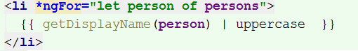
Angular Pipes with |
Equivalent of Angular JS filters
Used to format data for display
Pipes can be chained
Examples include: uppercase, lowercase, currency, date
We can write our own pipes!

Slide 51
Custom Pipe
We can create our own pipes (ng generate pipe or ng g p)
All we have to do is implement the transform method:
import { Pipe, PipeTransform } from '@angular/core';
@Pipe({
name: 'myOwnPipe'
})
export class MyOwnPipe implements PipeTransform {
transform(value: unknown, ...args: unknown[]): unknown {
// Format the value here and return the result
return 'some formatted value';
}
}
Notes:
Considering the above code, this pipe would be used as follows:
{{ 10 | myOwnPipe }} which would output “some formatted value”
Passing parameters to the pipe with the following syntax:
{{ 10 | myOwnPipe:’param1’:’param2’ }}
Would end up calling transform(10, ‘param1’, ‘param2’)

Slide 52
Lab P2 - Custom pipe
Create a custom pipe called currencyRenderer
The pipe will work as follows, assuming the input is always in US Dollars:
{{8.00 | currencyRenderer}} displays $8
{{9.55 | currencyRenderer}} displays $9.55
Then add two optional parameters: currency and exchange rate.
{{8 | currencyRenderer:’EUR’:1.20}} => 9.60 €
{{8 | currencyRenderer:’GBP’:1.42}} => £11.36
Notes:
You can use my tutorial at goo.gl/Gd496y to see another example of how to create a custom pipe.

Slide 53
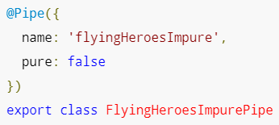
Pure and Impure Pipes
Pipes are pure by default
Angular executes a pure pipe only when it detects a pure change to the input value
A pure change is either a change to a primitive input value or a changed object reference
In order to change that and activate a more aggressive change detection mechanism, we make the pipe impure:

Slide 54
Chapter 6:
Services and dependency injection
What is a service in Angular?
Dependency injection in Angular
How to create a service?
www.angulartraining.com

Slide 55
Angular Services
Services are classes meant to handle application logic (fetch data, update data, etc.)
Services are differentiated from components to enhance reusability and modularity
Services are singletons: There is only one instance per injector
To turn a class into a service, we need the @Injectable() decorator applied to that class
Notes:
A service is an object that offers useful functionalities
Angular lets you factor your app logic into services and make those services accessible to components through dependency injection.
Separation of concerns is the main objective of using services in Angular applications.

Slide 56
Dependency injection
Angular relies on dependency injection to provide services to other objects such as components, directives, etc.
Dependency injection is a process where a class delegates the responsibility of providing its dependencies to external code (the injector)
Classes are not allowed to call the injector code. It is the injector that constructs the services and stores one instance of each.
Notes:
Here is a similar definition from Wikipedia:
In software engineering, dependency injection is a technique whereby one object (or static method) supplies the dependencies of another object. A dependency is an object that can be used (a service).
An injection is the passing of a dependency to a dependent object (a client) that would use it. The service is made part of the client's state. Passing the service to the client, rather than allowing a client to build or find the service, is the fundamental requirement of the pattern.

Slide 57
Dependency injection with Angular
To use a service, Angular relies on dependency injection to pass an instance of the service class into a component or object class. It is achieved by using a constructor.
Any class marked as @Injectable can be injected into an Angular object as follows:
export class ListPostsComponent {
constructor(postService : PostsService) {
Notes:
Note that all constructor parameters are supposed to be Injectable. As a result, a component cannot have a string or a number in its constructor parameters, as the Angular framework would not know how to inject those values.

Slide 58
Dependency injection
With Angular CLI, you can generate a service by running the following command:
ng generate service [name-of-service]
It will create the following initial code:
@Injectable({
providedIn: 'root'
})
export class TestService {
Notes:
A short way of creating a service is to run the following command: ng g s [name-of-service]
In this case, the command will create a service at the root of the application project.
The @Injectable decorator, which comes with the Angular core package, informs the Angular dependency injector that the class is available for injection as a dependency in other components or services
The providedIn property registers the service with Angular. A service provided with the default value of root can be used anywhere in the application.

Slide 59
Typescript - Constructor syntax
In Typescript, constructor parameters marked as public, private or protected are automatically turned into class properties:
export class ListPostsComponent {
constructor(public postService : PostsService) {
}
The above code is equivalent to:
export class ListPostsComponent {
postService : PostsService;
constructor(postService : PostsService) {
this.postService = postService;
}
}
The above code allows us to NOT have to declare theName as a class property - it is done automatically.
Notes:
In the above examples, the ListPostsComponent class has a public property called postService in both cases. Its value is automatically set to the value passed to the constructor, there's nothing more to do!

Slide 60
Lab S1 - Services
Using Angular CLI, create a new LicensePlateService that returns a list of LicensePlate through a getList() method
Inject that service into our AppComponent and retrieve the list of LicensePlate from there

Slide 61
Array of providers in app.module.ts
Before Angular 6, services had to be declared in an array of providers array in app.module.ts
The @Injectable() decorator did not have the providedIn option. It is still possible to use that array of providers:
@NgModule({
declarations: [...],
imports: [...],
providers: [
DataService,
LoginService
]
It is also possible to require injection of a specific sub-class:
Notes:
If a provider is registered with a specific NgModule, the same instance of a service can be accessed by every component in that NgModule.

Slide 62
Custom Dependency injection
Using the providers array in app.module.ts, we can customize dependency injection for every single service:
@NgModule({
declarations: [...],
imports: [...],
providers: [
DataService,
{ provide: LoginService, useClass: FakeLoginService}
]
})
export class AppModule { }
It is also possible to require injection of a specific sub-class:
Notes:
In the above example, whenever LoginService is required by a class, the injector is going to provide a FakeLoginService instead. This is a great way to provide a temporary implementation of a service while the server-side is being written for instance.
Another common use case for this is to provide a service with stubbed data for testing purposes.
Note that services listed in that array of providers just need the @Injectable() decorator and don’t have the providedIn: ‘root’ option in that decorator.

Slide 63
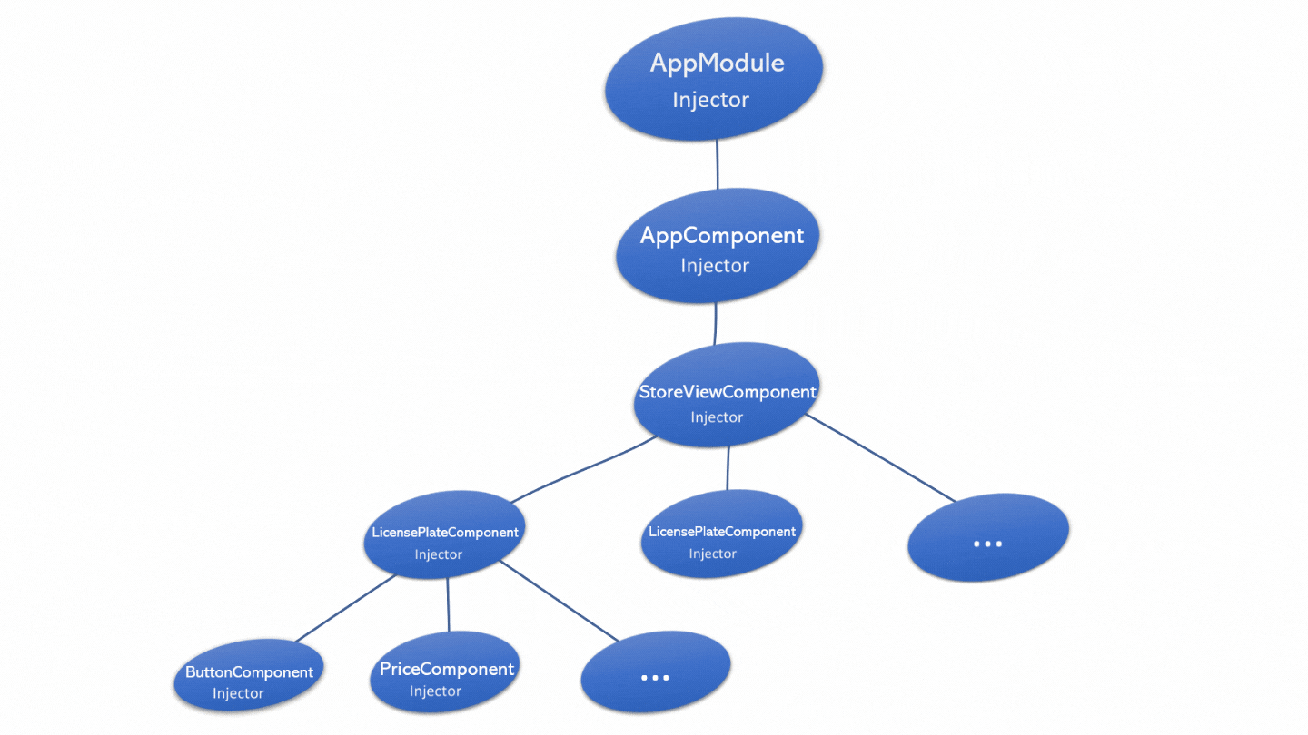
Injector tree
When a component needs
a dependency, it will check
its own injector, then its
parent’s injector, up to the
app module injector if needed.
That’s why most of the time we use providedIn: root to configure our services.

Slide 64
Custom Dependency injection at the component level
Using the providers array can be done at the component level to customize dependency injection for a specific component.
This is the exception rather than the rule though:
@Component({
selector: 'hello-world',
templateUrl: ...,
providers: [
{ provide: LoginService, useClass: FakeLoginService}
]
})
export class HelloWorldComponent{ }
It is also possible to require injection of a specific sub-class:
Notes:
In the above example, whenever LoginService is required by HelloWorldComponent, the injector of HelloWorldComponent is going to provide a FakeLoginService instead. Note that this specific injector will have its own instance of FakeLoginService, which has a result might not be a singleton anymore in the application.
You won’t need that kind of configuration 99.9% of the time, yet it’s important to know that dependency injection can be configured at the component level too.

Slide 65
Injector tree
Components can configure their own injector using the providers array
This changes dependency injection for the entire subtree of such components, as illustrated here.

Slide 66
Dependency injection: Inject function
Angular also exposes an inject() function that can be used to inject a service when:
Initializing a class property
Inside a constructor
Inside a provider declaration
inject(PostsService);

Slide 67
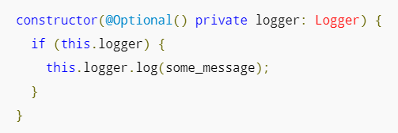
Dependency injection - @Optional
It is possible to mark a dependency as optional using the @Optional decorator:
When using @Optional, your code must be prepared for a null value in case no dependency is injected

Slide 68
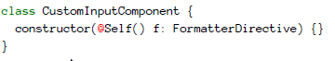
Dependency injection @Host and @Self
We can restrict a dependency to be retrieved from injectors of the same host (same HTML template) using the @Host decorator
The same goes for @Self, which will only retrieve dependencies on the same element:

Slide 69
Chapter 7:
Modules and build process
Modules and ngModule
Shared modules and feature modules
Different types of builds
Introduction to webpack
www.angulartraining.com

Slide 70
Angular ngModule
A module is a package of Typescript objects
Module
Components
Your own
classes
Pipes
HTML template
Services
Directives

Slide 71
Angular Module (ngModule)
A module file lists all dependencies and common imports
@NgModule({
declarations: [
AppComponent, HelloComponent, BindingsComponent
],
imports: [
BrowserModule,FormsModule
],
providers: [AuthGuard, LoginService, PostsService],
bootstrap: [AppComponent]
})
export class AppModule { }

Slide 72
Angular Module (ngModule)
A module also defines which component has to be bootstrapped (think “main” entry point of the app)
All of the modules imported in the main module file are made available to all of your classes

Slide 73
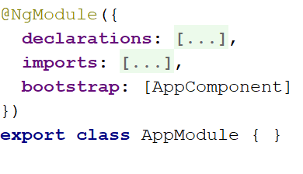
Bootstrapping an Angular application
@Component({
selector: 'app-root',
templateUrl: './app.component.html',
})
export class AppComponent {
<body>
<app-root>
Loading…
</app-root>
</body>
AppComponent
app.component.ts
index.html
AppModule
app.module.ts
4. AppComponent
gets loaded in index.html
3. AppModule
points to AppComponent
1. index.html loads main.ts
2. main.ts points
to the AppModule
main.ts
platformBrowserDynamic().bootstrapModule(AppModule);

Slide 74
Module Architecture: Feature module
It is recommended to have one module per feature-set, called a feature module
Examples of feature module for a store app:
Store module
Cart module
Checkout module
Admin module

Slide 75
Module Architecture: Feature module
Why feature modules?
They allow to group components / services /pipes by feature => easier to organize code
They allow lazy-loading:
Smaller initial app bundle size
Sensitive code can be hidden from users that are not supposed to see it (admin section for instance)

Slide 76
Module Architecture: Shared module
Every single component / service / pipe that is used by more than one feature module belongs to a shared module that exports its definitions to make them public:
@NgModule({
exports: [
ProgressBarComponent, DatatableComponent,
ConfirmDialogComponent, DatePickerComponent
],
declarations: [...],
providers: [LanguageService, WebStorageService]
})
export class SharedModule {
}

Slide 77
Module Architecture: Recap
Store
Module
Checkout
Module
Cart
module
Feature Modules:
Business logic
Actual screens
App
Module
imports
imports
imports
imports
exports
Shared
Module
Shared UI components: Datepicker
Shared services: Session, Translation
Shared directives: Data formatting

Slide 78
Lab A1: Angular Builds
Go to our labs folder ng2-training-master
Run ng build to compile the code of the entire project
Once the build completes, check the size of the dist folder. That’s your build output.
Now run a new build: ng build --configuration=production to see the difference in terms of size.

Slide 79
Introduction to Webpack
Webpack takes your code, transforms and bundles it, then returns a new ‘compiled’ version.
It can minify and optimize all types of files before serving them as one bundle to the browser.
It takes in various assets, such as JavaScript, CSS, Fonts, Images, and HTML, and then transforms these assets into a format that’s convenient to consume through a browser.
Angular CLI uses Webpack for its build process

Slide 80
Webpack Concepts
There are four core concepts you need to grasp to understand how Webpack works:
Entry: The input files to process (HTML, TS, CSS for Angular)
Output: The end result, the built files (minified, obfuscated JS, HTML and CSS)
Loaders: The tools that transform the entry files into the expected output
Plugins: Similar to loaders with super powers. Change and optimize the output files.

Slide 81
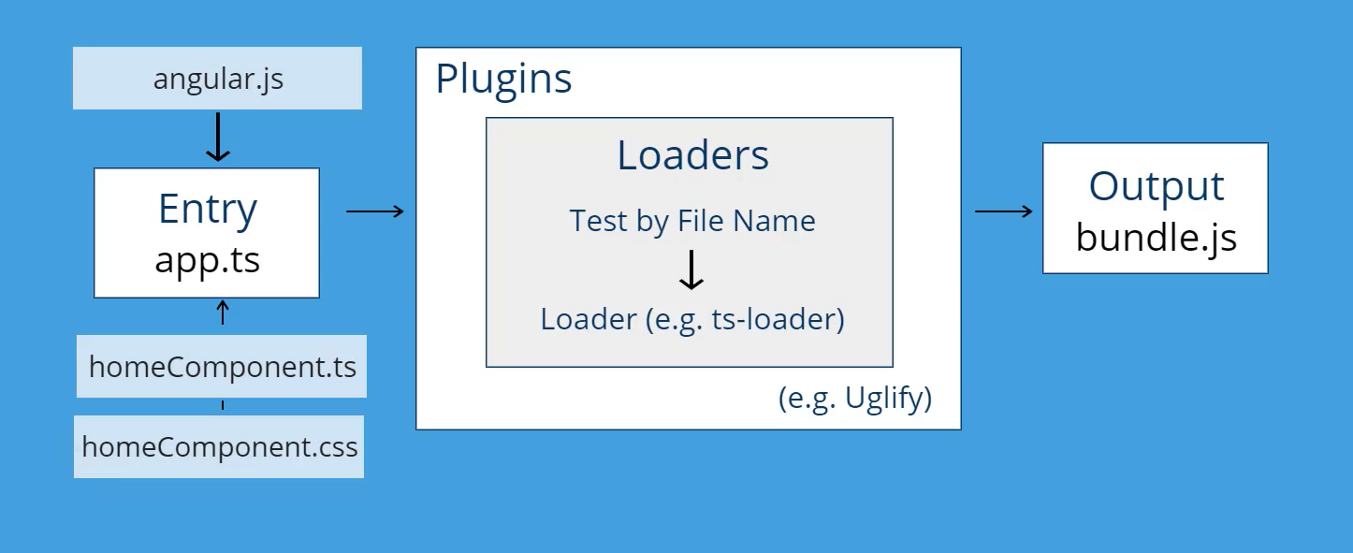
Webpack Flow

Slide 82
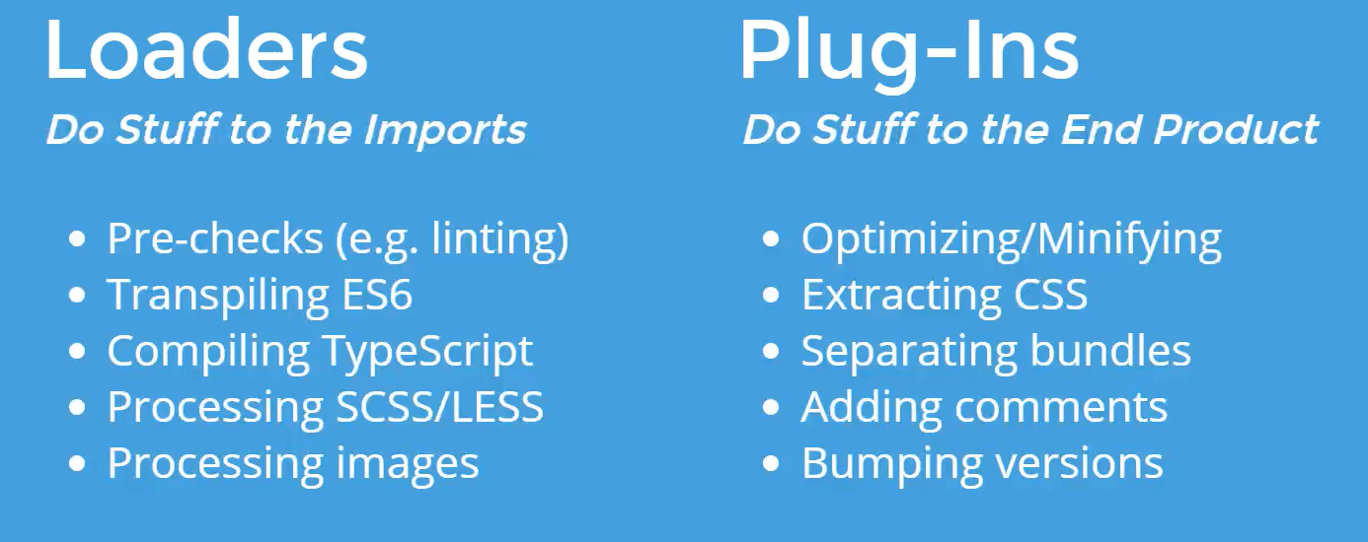
Webpack Loaders and Plugins examples

Slide 83
Should we use Webpack directly?
A main use case to try to tweak Webpack’s config is when you need to customize your build output
Angular CLI used to expose its Webpack config and make it available for you with one command:
ng eject
This is usually not advisable though, as you’re then stuck with one version of Angular CLI: You cannot get any updates anymore.

Slide 84
Should we use Webpack directly?
As a result, it is both easier and safer to create custom pre-build or post-build hooks with NPM in package.json whenever we need some customization:
"scripts": {
"ng": "ng",
"start": "ng serve",
"prebuild": "... do something custom",
"build": "ng build",
"postbuild": "... do something custom...",

Slide 85
Chapter 8:
RxJs Observables - Part 1
www.angulartraining.com

Slide 86
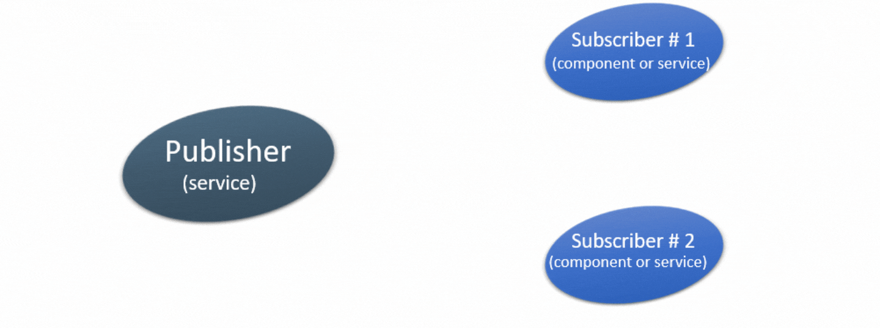
Observables from RxJs
RxJs is a powerful library that makes it easier to apply reactive programming concepts using Observables.
Observables provide support for passing messages between publishers and subscribers in your application. They offer significant benefits for asynchronous programming and handling multiple values.
Subscriber #1
(component or service)
Publisher
(service)
Subscriber #2
(component or service)
Notes:
RxJs (Reactive Extensions for JavaScript) provides an easy way to compose asynchronous and event-based programs through observable sequences
Reactive Programming is an asynchronous programming concept that is concerned with data streams as well as the propagation of change
Observables can be viewed as a sequence of items that arrive asynchronously over time

Slide 87
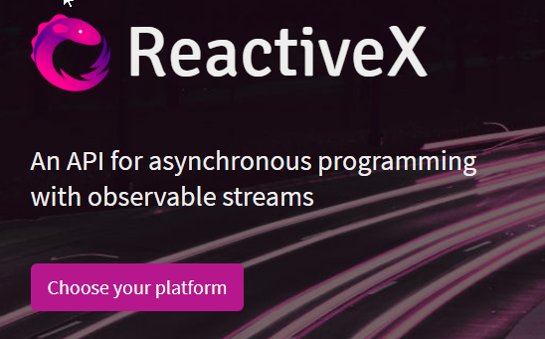
Observables from RxJs - reactivex.io
Observables implement the observer design pattern.
The official website is http://reactivex.io. It shows that ReactiveX has implementations for multiple languages.
In our case, we’re using RxJS (ReactiveX for JavaScript)
Notes:
Reactive Extensions (also known as ReactiveX) is a set of tools allowing imperative programming languages to operate on sequences of data regardless of whether the data is synchronous or asynchronous.
It provides a set of sequence operators that operate on each item in the sequence.
It is an implementation of reactive programming and provides a blueprint for the tools to be implemented in multiple programming languages.

Slide 88
Examples of use cases for Observables
In the Angular framework, Observables are used by multiple services to get notified:
Whenever the URL changes in the browser
When a form input value gets updated
When a HTTP request completes successfully
In our applications, Observables will be useful to broadcast information to several components (for instance: New user signs in, let’s notify every single component that needs user session information)

Slide 89
How to get data from an Observable
This is how we subscribe to an observable:
observable.subscribe((newValue) => {
this.currentSelection = newValue;
});
We have to call the subscribe method and pass a callback function as a parameter.
The callback function will be called every time the observable emits a new value.
That new value is passed as a parameter to the callback function.
Notes:
Demo URL
An observable can deliver multiple values of any type—literals, messages, or events, depending on the context. The API for receiving values is the same whether the values are delivered synchronously or asynchronously. Because setup and teardown logic are both handled by the observable, your application code only needs to worry about subscribing to consume values, and when done, unsubscribing. Whether the stream was keystrokes, an HTTP response, or an interval timer, the interface for listening to values and stopping listening is the same. Because of these advantages, observables are used extensively within Angular, and are recommended for app development as well.

Slide 90
Observable of()
A function that can be used to create an Observable out of any kind of object / value:
import {Observable, of} from 'rxjs'
canActivate() : Observable<boolean> {
return of(true);
}
Notes:
This is useful to return cached values or temporary test data while the actual asynchronous request is being developed.
For instance, the first time a method is called, it would perform an asynchronous task to fetch some data, and on subsequent calls, it would return an Observable of the cached data. That way the subscriber does not have to know about where the data comes from and uses the same method to fetch data or retrieve cached values.

Slide 91
Observable fromEvent()
A function that can be used to create an Observable out of any DOM event listener:
import { fromEvent } from 'rxjs';
// Create observable that emits click events
const source = fromEvent(document, 'click');
source.subscribe(val => console.log(val));
Notes:
This is useful to return cached values or temporary test data while the actual asynchronous request is being developed.
For instance, the first time a method is called, it would perform an asynchronous task to fetch some data, and on subsequent calls, it would return an Observable of the cached data. That way the subscriber does not have to know about where the data comes from and uses the same method to fetch data or retrieve cached values.

Slide 92
WebSockets in RxJs
RxJs also provides support with the Observable pattern:
import { webSocket } from 'rxjs/webSocket'
let subject = webSocket('ws://localhost:8081');
subject.subscribe(
msg => console.log('message received: ' + msg),
err => console.log(err),
() => console.log('complete')
);

Slide 93
Lab RX1 - Observables
Update your LicensePlateService from the previous lab to make getList() return an Observable
Update your component accordingly so that it subscribes to the LicensePlateService to get its data.

Slide 94
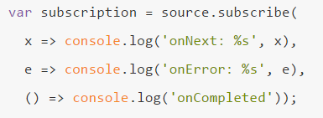
Observable Pattern
Observables use the subscribe function to register success, error and completion callbacks:
The value of x is the value passed to the next function in the observable definition
The value of e is the value passed to the error function in the observable definition
Notes:
A subscription can also be stopped using the unsubscribe() method. Any Angular component using observables MUST unsubscribe their subscriptions when they get destroyed to avoid memory leaks.

Slide 95
Unsubscribing from an observable
When we subscribe to an Observable, that method returns a Subscription object
A best practice is to always unsubscribe your Observables in the ngOnDestroy method of your classes:
export class ListPostsComponent {
subscription: Subscription;
constructor(private postService: PostsService) {
this.subscription = this.postService.getPosts()
.subscribe(p => this.posts.push(p));
}
ngOnDestroy() {
this.subscription.unsubscribe();
}
}
Notes:
Demo URL
Unsubscribing from an Observable allows garbage collection to happen in the browser. If you don’t unsubscribe, your code is going to keep references to old, unused subscriptions, which can cause memory leaks over time.

Slide 96
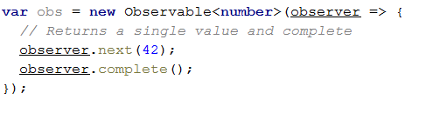
Creating your own observable
The constructor for the Observable class takes an observer object as a parameter, which has three methods:
next returns the next value to all subscribers
complete is called when all data has been sent to subscribers
error when an error occurs
Notes:
As we saw earlier, it is also possible to define an Observable that resolves immediately with of: var o = of(42);
In that case, the observable result is the value 42.

Slide 97
Chapter 9:
HTTP Client
www.angulartraining.com

Slide 98
Angular HttpClient
Angular service for http requests (AJAX)
Works seamlessly with JSON data and REST
Returns an Observable object
Notes:
In the above example we request JSON data from a server and assign it to a “persons” property of our component.
The HTTP service supports all of the HTTP verbs: GET, POST, PUT, DELETE, etc.
This makes the integration with a REST server very easy.

Slide 99
Angular HttpClient
HttpClient is a service that can be injected
Note the use of generics to specify the type of the response:
import {HttpClient} from '@angular/common/http';
@Injectable()
export class CartService {
constructor(private http: HttpClient) { }
getCartContents(): Observable<LicensePlate[]> {
return this.http.get<LicensePlate[]>('http://localhost:8000/cart');
}
Notes:
Note that HttpClient has to be imported from @angular/common/http, and that the HttpClientModule also has to be imported in your AppModule.

Slide 100
Lab HT1 - Using the HttpClient
Run npm run server in a terminal in our project directory in order to start the back-end server
Change the LicensePlateService code to load a list of license plates from http://localhost:8000/data
Implement a ngOnDestroy method in AppComponent where you’re going to unsubscribe from your observable. This method is invoked by Angular when your component is removed from the DOM

Slide 101
Http Interceptor
In order to intercept HTTP requests and responses, you can create a Http Interceptor service:
@Injectable()
export class NoopInterceptor implements HttpInterceptor {
intercept(req: HttpRequest<any>, next: HttpHandler): Observable<HttpEvent<any>> {
// Do some work with the request / response
return next.handle(req);
}
}
Notes:
Full guide on HTTP request interception can be found here: https://angular.io/guide/http#intercepting-requests-and-responses
Some use cases for such interceptors:
Handling errors to log them or display a message to the user
Automatically add an authentication token to every outgoing request
Change the format of the data that is sent or received (turn JSON data into XML for instance)

Slide 102
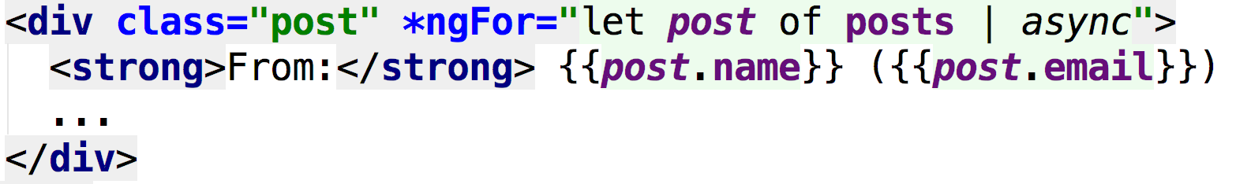
Async Pipe
Pipe to display data that comes from an Observable or a Promise
Automatically subscribes and unsubscribes:
Notes:
In the above code, posts is an Observable object initialized in the TypeScript code of our component.
Angular will automatically subscribe to that Observable, get its data, render it, and then unsubscribe when the component is destroyed.

Slide 103
Lab HT2 - Using the async pipe
Instead of subscribing to the observable from LicensePlateService in our AppComponent, let’s use the async pipe instead.
You’ll need to get a reference to the observable from the service, then apply the async pipe to that reference in app.component.html

Slide 104
Chapter 10:
Component router
What is the component router?
Example of component router in action
www.angulartraining.com

Slide 105
Angular Component Router
Angular was designed for Single Page Applications
But very often we need more than one page!
The Component Router allows us to emulate this by loading components based on URLs
For instance, /cart would load a Cart component, /login for login, etc.

Slide 106
Example of router implementation
Navigation
Dynamic content area where components
get loaded based on the URL
<router-outlet> </router-outlet>
Here the navigation component and the footer are always the same on all pages.
The only dynamic part is the blue section, determined by the <router-outlet> directive
Footer
Notes:
Any complex app will need to have several views. Instead of navigating to a new page, which would require a reload of your application, the component router allows to switch between different views easily.
Each view is a component that gets a loaded at a given location in our app. That location is where the add the <router-outlet> directive

Slide 107
Angular Component Router
Requires a routing table that maps URLs to components (app.routing.ts):
const appRoutes: Routes = [
{
path: '', component: MenuComponent
}, {
path: 'observable-example', component: ObservableExampleComponent
}, {
path: 'subject-example', component: SubjectExampleComponent
}
];
export const routing: ModuleWithProviders = RouterModule.forRoot(appRoutes);

Slide 108
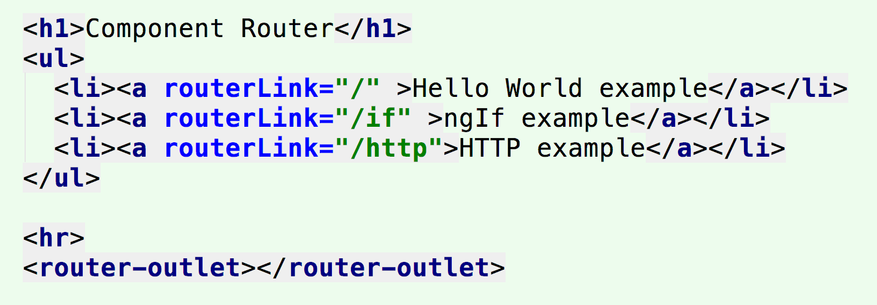
Angular Component Router
<router-outlet> is the place where routed components are loaded in the HTML. Router links can be used to navigate:
Notes:
Note the syntax for router links so that it’s possible to make an HTML link to a specific route.

Slide 109
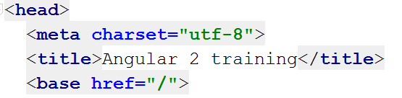
Angular Component Router
Also requires to add a base tag to index.html
The reason for this is to indicate which portion of the URL is managed by Angular, and which one is managed by the server (this also requires some server config)
Notes:
In the above example, this means that your app is basically deployed at the root of its domain, for instance www.gmail.com.
If your app is deployed in a “subfolder”, like www.mydomain.com/myapp, then you need to specify <base href=”/app”> in index.html
It is also important to configure your server so that any URL that is relative to myapp actually returns myapp/index.html, so that the browser will load the Angular app which will then handle its part of the URL and load the right component.
For instance, if a user types in their browser www.mydomain.com/myapp/profile, the server should actually return www.mydomain.com/myapp/index.html, and your Angular application would have a route definition that maps a component to /profile.

Slide 110
Lab R1 - Component Router
We’re going to have three different views: A store view, a checkout view, and a cart view
The StoreViewComponent is going to be the default one, rendered when the URL is http://localhost:4200
Then CartViewComponent is going to be rendered when the URL is http://localhost:4200/cart
Finally CheckoutViewComponent is going to be rendered when the URL is http://localhost:4200/checkout
Notes:
STEP BY STEP INSTRUCTIONS:
Open a new terminal and run ng g c StoreView to create a StoreViewComponent
Open src/app/app.component.html and cut all of the contents of the HTML tag <main role="main">
Now go to src/app/store-view/store-view.component.html and paste the previous contents as the new template for that component. Remove the default HTML that was generated in that file.
Back to src/app/app.component.html, add the router outlet directive to the main tag we edited earlier: <main role="main">
<router-outlet></router-outlet>
</main> This is the place where components are now going to be rendered based on the current URL.
Open src/app/app.component.ts and cut all of the contents of the AppComponent class, which should then be empty.
Paste that code into the StoreViewComponent class (src/app/store-view/store-view.component.ts). This component is our new main view with all the license plates, and AppComponent is now just a container for that view boxed by the navigation component and the footer.
Once you have done that, change the routing config in app.routing.ts to make those components load as follows:
const appRoutes: Routes = [
{
path: '', component: StoreViewComponent
},
{
path: 'cart', component: CartViewComponent
},
{
path: 'checkout', component: CheckoutViewComponent
}
];

Slide 111
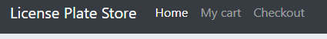
Lab R1 - Component Router
Once your routing config is ready, you can test it by typing the different URLs in your browser window.
If everything works, then make the navigation links work properly so we can navigate using those:
Take a look at the router guide if you need any help: https://angular.io/guide/router
Notes:
STEP BY STEP INSTRUCTIONS CONTINUED:
Open src/app/navigation/navigation.component.html and add router links as highlighted below:
<li class="nav-item">
<a class="nav-link" routerLink="">Home <span class="sr-only">(current)</span></a>
</li>
<li class="nav-item">
<a class="nav-link" routerLink="cart" >My cart <span class="sr-only"></span></a>
</li>
<li class="nav-item">
<a class="nav-link" routerLink="checkout">Checkout <span class="sr-only"></span></a>
</li>
2) Now head to http://localhost:4200 in your browser and try to navigate to different views using the navigation component.

Slide 112
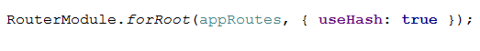
Component Router: Location Strategy
By default, the router uses the PathLocationStrategy using the pushState API from HTML5
Older browsers might require the use of the HashLocationStrategy instead (which was the default in Angular JS)
In order to use it, configure your router as follows:

Slide 113
Router Service
Angular has a Router service that can be used to navigate programmatically:
constructor(private router: Router) {
this.router.navigateByUrl('login');
}
This service can also be used to change the router config at runtime to dynamically add or remove routes.

Slide 114
Child Routes
It is possible to define child routes as follows, in which case the AdminComponent needs its own <router-outlet>:
/admin/users
path: 'admin',
component: AdminComponent,
children: [
{ path: 'orders', component: ManageOrdersComponent },
{ path: 'users', component: ManageUsersComponent },
{ path: '', component: AdminDashboardComponent }
]
Notes:
In that case, /admin/orders displays ManageOrdersComponent as a child of AdminComponent, while /admin displays AdminDashboardComponent as a child of AdminComponent.

Slide 115
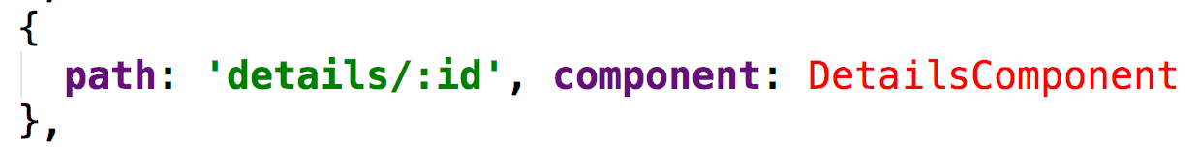
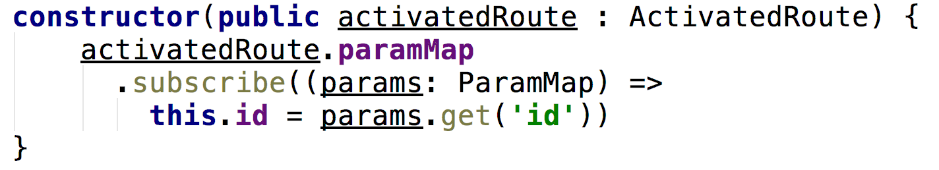
Passing Parameters to Routes
Parameters have to be named in the router config:
Then parameters can be retrieved by injecting the ActivatedRoute service and subscribing to paramMap:
Notes:
As a result, in the above example, if the URL is details/21 , ActivatedRoute.params[‘id’] would be equal to 21.
Navigating to that URL programmatically in TypeScript could be achieved with: this.router.navigate(['/details', { id: 21 }]);

Slide 116
Guards for Authentication
Prevent routes from being accessed using a guard:
A guard implements a canActivate method and simply returns true if the route is allowed, false otherwise:
import {CanActivate, Router, UrlTree} from '@angular/router';
@Injectable()
export class AuthGuard implements CanActivate {
constructor(private loginService: LoginService, private router: Router) {}
canActivate(): boolean | UrlTree {
return this.loginService.isUserLoggedIn() || this.router.parseUrl('login');
}
}
Notes:
Note that canActivate can also return an Observable of boolean (so you can make an asynchronous check before returning a value), or a UrlTree, which is a way to tell the router to redirect the user to a specific path.

Slide 117
Lab R2 - Authentication
Use the AuthGuard service provided in the router folder to guard the /checkout route.
Then create a new, unguarded route to the LoginComponent provided in router/login
Update the AuthGuard code to return false if the user is not logged in (using the provided LoginService)
Complete the authentication feature by adding proper router redirects to /login and /checkout where needed.
BONUS
Notes:
BONUS STEPS:
Add a navigation link to /login in the header, which gets hidden once the user is logged in

Slide 118
Lazy-loading with the Router
Features can be grouped in sub-modules that will be downloaded lazily by Angular
The main benefit is to make the main Javascript bundle smaller
Another benefit is to hide sensitive code from users who don’t have access to it (i.e. an admin section of your app)

Slide 119
Lazy-loading with the Router
To create a new module with Angular CLI:
ng generate module mySubModule
Lazy-loaded modules can have their own child routes
Then don’t import it in app.module.ts, and route to it as follows:
{
path: 'admin',
loadChildren: () => import('app/admin/admin.module')
.then(m => m.AdminModule)
}
Notes:
In the above code example, when a user tries to access the path /heroes/dashboard in their browser, it would download the code for the HeroModule, load the route definitions for that module and then load the component associated to the /dashboard route of that module.
The code for both HeroModule and CrisisModule won’t be included in the main Javascript bundle of the app.
Both of them will be downloaded lazily whenever they are needed.

Slide 120
Chapter 11:
Forms
How to handle forms with Angular?
Template driven forms and event driven forms
Form validation and submission
www.angulartraining.com

Slide 121
Forms in Angular
Angular provides tools to facilitate form management:
Data bindings
Form submission
Form validation
Error handling
There are two different ways to handle forms:
Template-driven
Reactive Forms
Notes:
A template driven form has its validation code defined in the HTML template.
Model driven forms have their code defined in TypeScript, within your component.

Slide 122
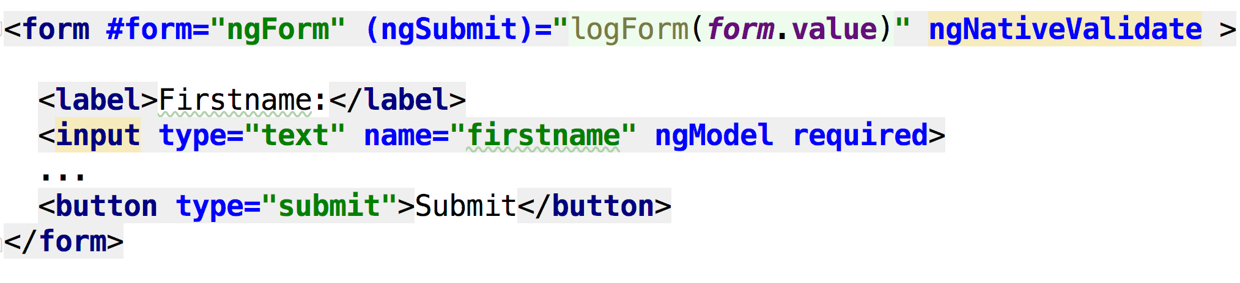
Let’s start with Template-Driven forms
Example available in the forms folder

Slide 123
Specific classes and properties
Angular sets CSS classes and model properties on each form element as well as on the entire form:
Pristine when no value has been changed
Dirty when a value has been changed
Valid when the entered value is valid
Invalid otherwise
Touched when an element got focus, then lost it
Untouched otherwise
Notes:
Note that all of these values go in pairs. An element can be pristine or dirty, not both at the same time.
The entire form is pristine by default and becomes dirty as soon as any form element becomes dirty. The same goes for touched.
The entire form becomes valid when of all its elements are valid.

Slide 124
How to access these properties?
These properties are exported by the ngForm directive as follows:
<form #form="ngForm" (ngSubmit)="logForm(form.value)">
Form valid: {{form.valid}}
Form dirty: {{form.dirty}}

Slide 125
How to access these form properties?
These properties are also exported by the ngModel directive:
<input type="text" name="street" #street="ngModel" ngModel>
Street is valid {{street.valid}}

Slide 126
Lab F1 - Form validation
BONUS
We’re going to edit the CheckoutFormComponent
Test the form and understand how it works
Make the zipcode field mandatory
Add some validation to make sure that zipcode is a 5-digit number (using the pattern HTML attribute)
Display a red error message next to the zipcode field if the value entered is not valid
Notes:
BONUS STEPS:
Add a dropdown to pick a US state from a list.
Use the following data to load the full list of states with an HTTP request: http://localhost:8000/states
On submit, send the data with HTTP POST to: http://localhost:8000/checkout and display a pop-up window to confirm the successful order

Slide 127
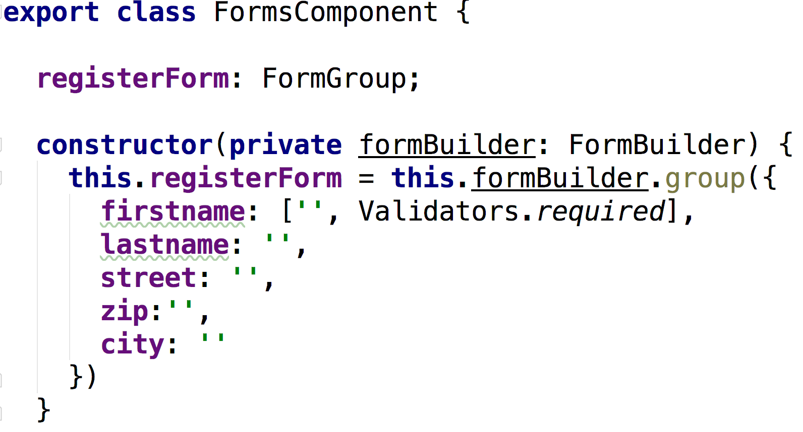
Reactive forms
The set-up of the form happens in TypeScript instead of in the HTML template:

Slide 128
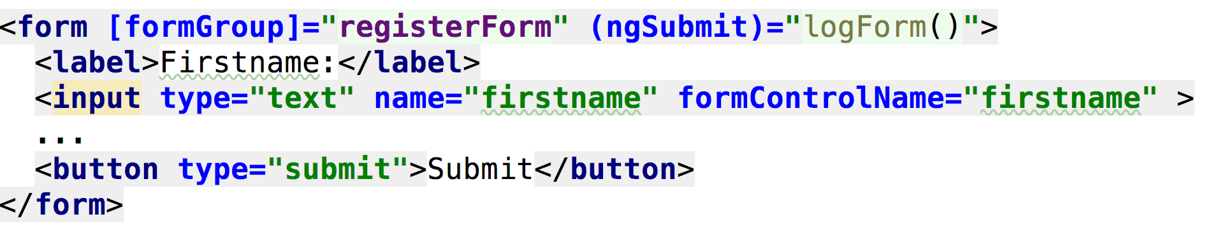
Reactive forms
We bind the formGroup property to our registerForm property, which turns the form into a reactive form:
Then we can access every element by name from the controls property: registerForm.controls.firstname

Slide 129
Form Control Observables
Every single FormControl provides Observables to get notified when their value changes (valueChanges) or their validity changes (statusChanges):
this.registerForm.controls.zip.valueChanges
.subscribe((value) => //Do something with each new value);

Slide 130
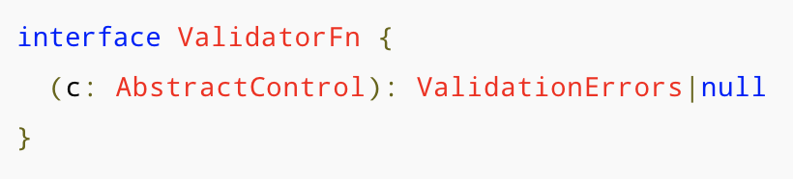
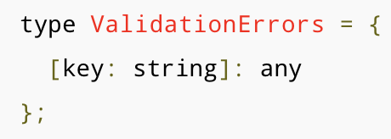
Custom Validation
We can create our own validation functions. Here is what a validator function is supposed to look like:
ValidationErrors are a list of keys and values as follows:
Notes:
I have a tutorial with an example of custom form validation here: https://blog.angulartraining.com/how-to-implement-custom-form-validators-with-angular-861651b0dc2c

Slide 131
Reactive form with custom validation
Demo code: project/demos/src/app/forms
Let's take a look at a custom validator function to validate that the credit card number entered by the user has to have 16 digits (credit-card-validator.directive.ts)
Validation also checks that the credit card number must start with either 37 for American Express, 4 for Visa, or 5 for Mastercard.

Slide 132
Chapter 12:
RxJs Part 2 - Operators and Subjects
www.angulartraining.com

Slide 133
Marble diagrams
Observables are perfect to subscribe to a stream of events, and as a result an Observable’s lifecycle is usually represented with a timeline such as this one, known as a marble diagram: The above example of Observable emits 5 different values over time (circles/marbles in the timeline), before completing some time later ( | in the timeline)

Slide 134
RxJs Operators
rxjs/operators
Operators are pure functions that take one or more Observables and return a modified Observable
Operators are used to transform/filter/concatenate information from one or more sources
RxJs has over 120 operators available!
Operators are applied to an Observable using the pipe method:
observable.pipe(
map(data => data.toUpperCase())
).subscribe(newValue => {
this.currentSelection = newValue;
});
Notes:
Operators offer the best way of consuming or utilizing Observables. With an operator, you can manipulate, change, or filter an Observable to yield a desired result.

Slide 135
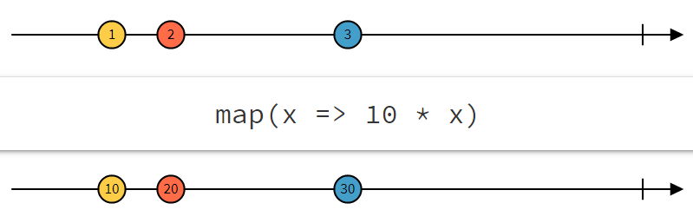
RxJs Operators: map
rxjs/operators
Below is an example of the map operator used to apply a transformation to the data coming from an Observable
Operators are usually documented with diagrams called marble diagrams:
Notes:
The above example illustrates the map operator. This operator takes every single value from an Observable and applies a transformation to them, then emits the updated value.
Marble diagrams always represent the input observable at the top, then the operator with a sample configuration (in our case, the operator is set to multiply any input value by 10), and the output observable at the bottom.
The timeline from left to right represents different values emitted by the observables over time. The vertical line on the right-hand side represents the completion of the observable. No more value can be emitted after that.
Demo URL

Slide 136

Operators with our newspaper subscription example
When we subscribe to a newspaper, we expect to receive several issues over time.
It's likely that we don't need the contents of the entire newspaper: Some people will clip the coupons page, others will read the sports news only.
That's what operators do: They tweak what we do with a subscription to make it match our expectations.
As a result, operators can filter out some data, aggregate some information, etc.

Slide 137
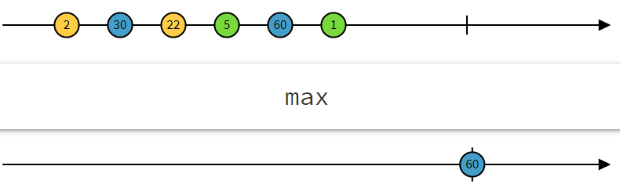
RxJs Operator: max
rxjs/operators
max is a mathematical operator. It returns a single value, which is the maximum value emitted by the input observable as soon as the subscription is completed:

Slide 138
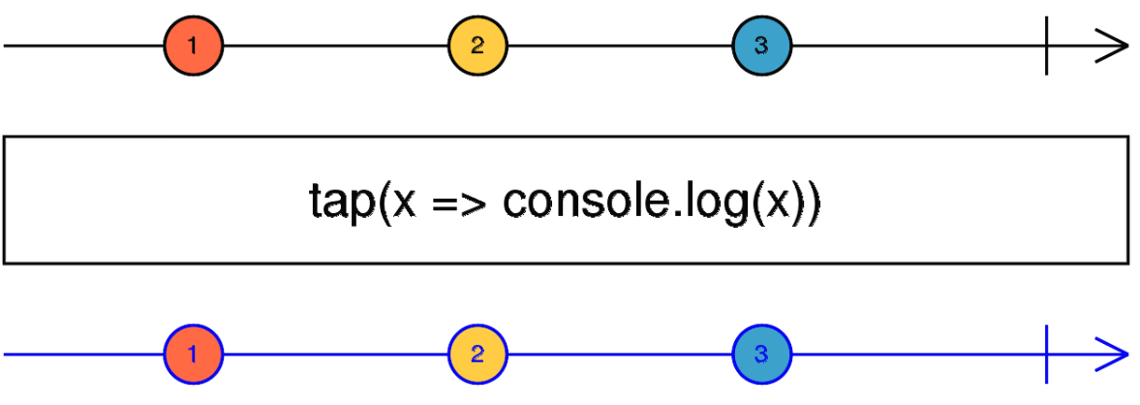
RxJs Operator: tap
rxjs/operators
tap returns an Observable identical to the source, but runs the specified callback for each item - a way to “spy” on an Observable and run some side-effects on its data:

Slide 139
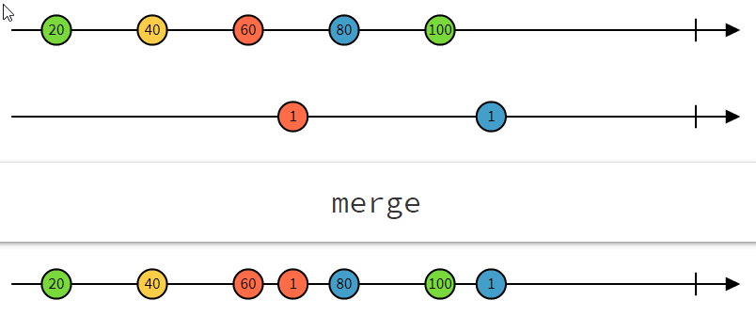
RxJs Operator: merge
rxjs/operators
merge is a combination operator. It merges two different observables into one:

Slide 140
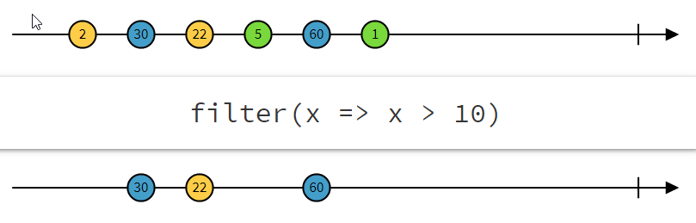
RxJs Operator: filter
rxjs/operators
filter is a filtering operator. It filters out data that doesn’t match a given condition:

Slide 141
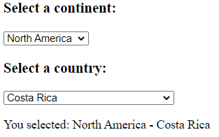
RxJs Operators
rxjs/operators
More examples of operators can be found at http://rxmarbles.com
Let’s take a look at an example that combines two different Observables into one:
this.continentSelect.valueChanges.pipe(
tap(continent => console.log(continent)),
withLatestFrom(countryList$)
).subscribe(([continent, countries]) => {
this.countries = countries.filter(country => country.continent === continent);
});
Notes:
Demo URL

Slide 142

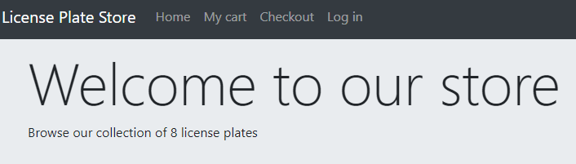
Code Challenge - Using operators
Change our application code so the jumbotron component displays the total number of license plates in its description
That number should depend on the data downloaded from the server
CHALLENGE

Slide 143
RxJs Subjects
An RxJS Subject is a special type of Observable that allows values to be sent to many Observers
In other words, a subject can emit data, on top of having the capability to be subscribed to
Subjects are like EventEmitters: They maintain a registry of many listeners (they are multicast)

Slide 144
RxJs Subjects
rxjs
There are several kinds of subjects:
Subject Emits next value to current subscribers
BehaviorSubject Emits latest value to current and future subscribers
ReplaySubject Emits one-or-more previous values to future subscribers
AsyncSubject will only emit the last value upon completion of the Observable
Notes:
Demo URL
For more examples and demos of the different kinds of subjects: https://blog.angulartraining.com/rxjs-subjects-a-tutorial-4dcce0e9637f

Slide 145
Code Challenge - Using a Subject
Create an exchange rate service that is going to poll http://localhost:8000/rates every 30 seconds to get the latest currency exchange rates
Updated exchange rates have to be emitted using a Subject so that components can subscribe to it to receive updates
CHALLENGE

Slide 146
Chapter 13:
Component communication and lifecycle
How to make components share data?
Introduction to the component lifecycle
Lifecycle hooks
www.angulartraining.com

Slide 147
How to do it with Angular: Services
Component 1
One way to achieve data-sharing between components is to use a service to do that
Services are singletons so these components would access the same data once loaded
Data Service
Component 2

Slide 148
Lab CC1 - Component communication
BONUS
Use the partially created CurrencySwitcherComponent in our webapp header:
Update our application so that when a user selects a new currency with that component, the change is immediately reflected on all of our license plate prices.
Notes:
BONUS STEPS:
Use a Subject to emit currency information to all subscribers
Get the exchange rates from http://localhost:8000/rates and use those values

Slide 149
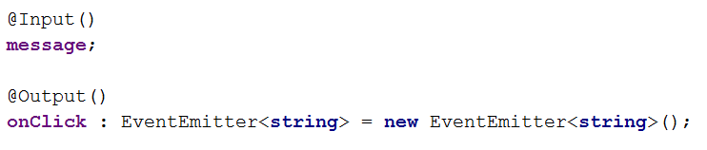
Angular Component Communication
An Angular app is a tree of components
Components can interact with one another
@Input() and @Output() are decorators made to achieve that
Notes:
Component interaction mostly means: How to pass data from one component to the other? How can a component notify other components that something specific happened?

Slide 150
Component Communication
Let’s take a look at the dialog component demo
This dialog shows up as an overlay that can be controlled with an @Input() property called isOpen.
[isOpen] is a way to control the visibility of the pop-up
(onClose) is a way to get notified when the user closes the pop-up
Notes:
Output() requires the use of an EventEmitter object to send events, as implemented in our example.

Slide 151
Content projection with ng-content
We can also pass a template to a child using transclusion. For instance:
<app-dialog >
This is content passed to the dialog
</app-dialog>
And then in order to render that content in the child component, we use the ng-content directive:
<div class="modalW-body">
<ng-content></ng-content>
</div>
Notes:
In the above example, the text “This is content passed to the pop-up” would actually be rendered where <ng-content> is located in the template of app-popup-window. This is what is called transclusion in the Angular world.

Slide 152
ViewChild
An alternative is to use the @ViewChild decorator to access a child component directly:
@ViewChild(PopupWindowComponent)
popup: PopupWindowComponent;
showPopup() {
this.popup.isOpen = true;
}
Notes:
In that case Angular will inject the first child that matches the selector, which means @ViewChild is not the right option if you need to communicate with several child components from the same type. In that case, you would use @ViewChildren instead.
Note that there are also @ContentChild and @ContentChildren decorators to select transcluded components in <ng-content>
Inputs and outputs are the preferred approach as they make the interaction explicit in both the parent and the child component.

Slide 153
Lab CC2 - “Add to cart” feature
Change LicensePlateComponent so that it sends an event when an item gets added to the cart (@Output)
Then have AppComponent call CartService to add the plate to the cart
Complete the CartService to reach the back-end when a plate gets added to the cart: HTTP PUT /cart/id (id being the actual LicensePlate id)

Slide 154
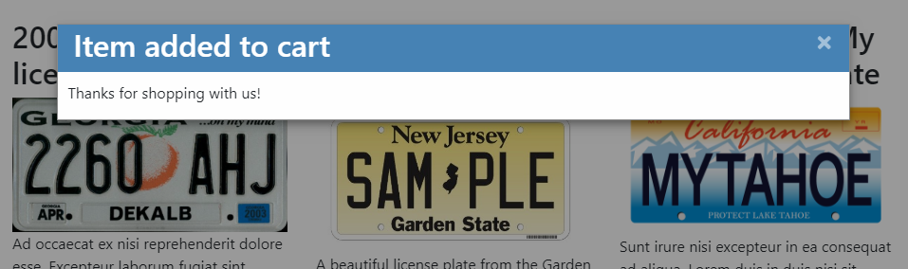
Lab CC2 - “Add to cart” feature
Finally, once the service returns successfully, display a PopupWindowComponent to confirm success as shown below:

Slide 155
Angular LifeCycle Hooks
Hooks are component methods called during different phases of the component lifecycle
Useful if you need some JS work done when data gets updated for instance (ngOnChanges) or on init (ngOnInit)
https://angular.io/docs/ts/latest/guide/lifecycle-hooks.html
Notes:
A lifecycle hook is basically a callback function that you can define in your component to receive specific notifications during the lifecycle of the component.

Slide 156
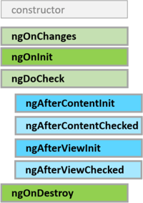
Angular LifeCycle Hooks
First the component constructor is called
Then when @Input properties get new values, ngOnChanges is called
Once all @Inputs have their initial value, ngOnInit is called
Finally, when the component is removed from the DOM, ngOnDestroy is called
Notes:
ngOnDestroy should be used to unsubscribe from all of the observables we subscribed to.
ngOnInit can be used to do some work (like loading data) as at that point in time we know that all Inputs have their initial value.
ngOnChanges should be used to refresh our data when Inputs get a new value. Note that the list of changes is passed as a parameter to that method,s o we can now which input changed, what was the previous value, what is the new value.

Slide 157
Change detection: Zone.js
Angular relies on a library called Zone.js for change detection
Zone.js overrides all AJAX requests, call to setTimeout,and any JS code that could result in data updates
Once Zone.js thinks some data might have changed, Angular is notified and checks if components have to be refreshed

Slide 158
Change detection: ngZone
Sometimes we use JS libraries that are not wrapped within Angular code (jQuery, Google Maps, etc.)
In order for Angular to detect changes from such libraries, it is advised to run that within a Zone from Zone.js using the ngZone service:
constructor(private zone: NgZone) {
this.zone.run(() => {
this.someProperty = jQuery.something();
});
}

Slide 159
Change Detection Strategies
There are two possible strategies: Default and OnPush
OnPush will only check for Changes when @Input properties change
Default will check for
updates any time something
might change
@Component({
selector: 'app-jumbotron',
templateUrl: './jumbotron.component.html',
styleUrls: ['./jumbotron.component.css'],
changeDetection: ChangeDetectionStrategy.OnPush
})
export class JumbotronComponent {
@Input()
title;
@Input()
description;
}
Notes:
The above code shows how to switch the default mode to “onPush” in the component’s decorator.

Slide 160
Chapter 14:
Advanced projects & tools
www.angulartraining.com

Slide 161

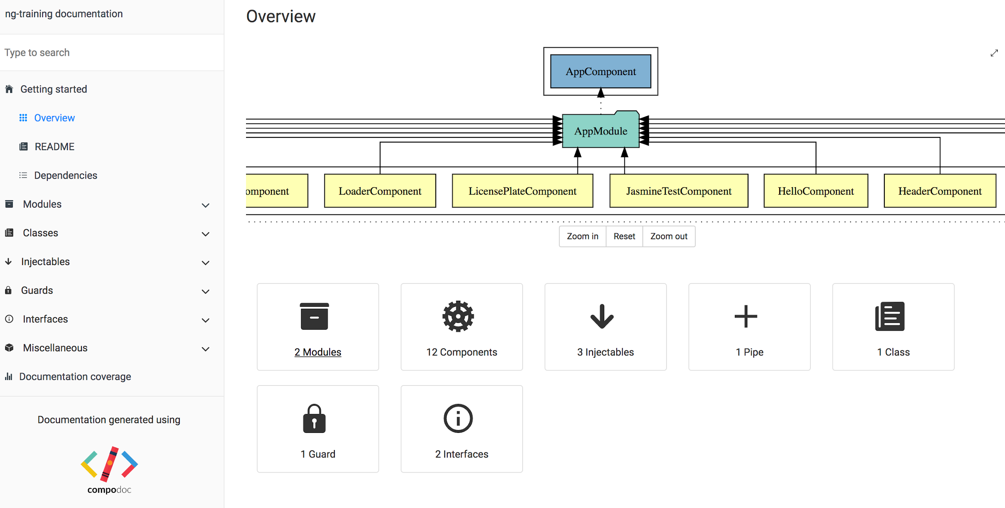
Compodoc
A command line tool to generate documentation for your Angular app
Website: https://compodoc.app/

Slide 162

Angular Custom Elements
Turn a component into an independent HTML element that you can use on any webpage, even if it’s not an Angular project!
All you’ll have to do is import a tiny bundle of JS code for that custom element
Notes:
This is still work in progress as some of these features are not fully supported by all browsers. Yet it’s a great feature to follow for the future.
Custom elements bootstrap themselves - they start automatically when they are added to the DOM, and are automatically destroyed when removed from the DOM. Once a custom element is added to the DOM for any page, it looks and behaves like any other HTML element, and does not require any special knowledge of Angular terms or usage conventions.
For a tutorial on how to build custom elements, feel free to head to my blog: https://blog.angulartraining.com/tutorial-how-to-create-custom-angular-elements-55aea29d80c5

Slide 163
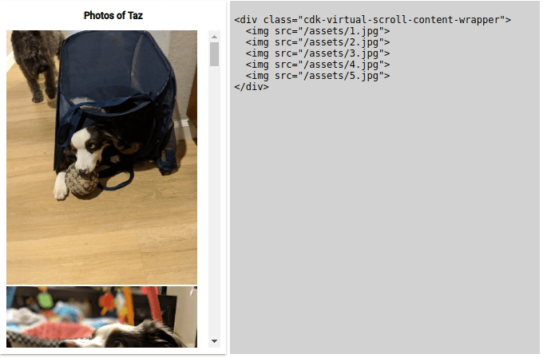

Angular CDK
Component development kit for Angular
https://material.angular.io/cdk
Notes:
The CDK is maintained by the Angular Material team.
It has a lot of popular web app features (overlays, drag and drop, pop-ups, virtual scroll, etc.) that do not require Angular Material and that you can use with your own components.
As illustrated above, using simple directives is all we need to get such features in our code.

Slide 164

Angular Universal
Server-side rendering for Angular apps
https://universal.angular.io
Optimize your app for speed and SEO (search engine optimization)
Angular TypeScript code runs on a Node.js server and returns “static” HTML

Slide 165


Angular Augury
Google Chrome Dev Tools extension for debugging Angular applications
https://augury.angular.io/
Visualize the application through component trees, and visual debugging tools.
Notes:
This project is fully released and the best debugging tool for Angular.

Slide 166
Chapter 15:
Testing Angular Applications
www.angulartraining.com

Slide 167
How to test Angular applications?
Angular has always been a test-friendly framework, with dependency injection as a way to inject test data easily
As a result, it supports Jasmine, the most popular Javascript testing framework
Angular CLI generates Jasmine test specs automatically and brings tooling for Jasmine, Karma and Protractor testing.

Slide 168
How to test Angular applications?
The full testing guide can be found here: https://angular.io/guide/testing
It’s a complete guide with examples for a lot of different test cases
Angular provides testing utilities (TestBed) that create a test environment for the Angular application code under test (custom dependency injection, etc.)
Notes:
TestBed allows you to instantiate any component, service, pipe under test with custom dependency injection so that you can use mock or fake objects when needed.

Slide 169
Jasmine
Example of code
function helloWorld() {
return 'Hello world!';
}
Jasmine test for that code
describe('Hello world test', function () {
it('says hello', function () {
expect(helloWorld()).toEqual('Hello world!');
});
});
Jasmine is an open source testing framework for JavaScript.
Jasmine aims to be easy to read: Code can almost read just like plain English sentences

Slide 170
Jasmine:
Describe
describe('Hello world test', function () {
it('says hello', function () {
expect(helloWorld()).toEqual('Hello world!');
});
});
The describe function is for grouping related specs (tests), typically each test file has one at the top level.
The string parameter is for naming the collection of specs, and will be concatenated with specs to make a spec's full name.

Slide 171
Jasmine:
Specs with it()
describe('Hello world test', function () {
it('says hello', function () {
expect(helloWorld()).toEqual('Hello world!');
});
});
Specs are defined by calling the it function, which takes two parameters:
The string is the title of the spec and the function is the test itself.
A spec contains one or more expectations that test the state of the code.

Slide 172
Expectations and matchers
expect(helloWorld()).toEqual('Hello world');
expect(1+1).toBe(2);
expect(false).not.toBe(true);
expect([1, 2, 3]).toContain(2);
expect(2).toBeLessThan(3);
Expectations are built with the function expect which takes a value, called the actual.
It is chained with a Matcher function, which takes the expected value.

Slide 173

Karma
Karma is a test-runner that simplifies the entire testing workflow - https://karma-runner.github.io
Karma has a minimalist config, generates test reports and is already integrated with most continuous integration servers (Jenkins, Travis)
With Angular CLI, just run ng test to have karma run all of your Jasmine tests
Notes:
Pro tip:
To focus a test run on specific test cases, you can use the “f” prefix (f for focus) in front of a describe or a it function, which becomes fdescribe or fit. Karma will only run the tests that have that prefix when you use it.
In a similar fashion, you can exclude some tests that are work in progress by using the “x” prefix (x for exclude). As a result, specs renamed xdescribe would not be run by Karma.

Slide 174


Karma Report
Karma runs in a browser and reports all tests that pass and all tests that fail, using the texts provided in Jasmine to give us explicit descriptions of what worked and what didn’t:

Slide 175
fdescribe, xdescribe, fit, xit
// Focus on that describe function only
fdescribe('CurrencyRendererPipe', () => {
const service = new CurrencyService();
it('should format USD amounts properly', () => {
const pipe = new CurrencyRendererPipe(service);
expect(pipe.transform(12.558)).toBe('$12.56');
});
// Exclude that test for now
xit('should format EUR amounts properly', () => {
service.setCurrency('EUR');
const pipe = new CurrencyRendererPipe(service);
expect(pipe.transform(12.558)).toBe('12.56€');
});
});
To focus on specific test cases, you can use the “f” prefix (for focus) in front of a describe or a it function. In a similar fashion, you can exclude some tests that are work in progress by using the “x” prefix (x for exclude).

Slide 176
Lab T1 - Writing Unit Tests
We will be testing the CurrencyRendererPipe
Look at currency-renderer.pipe.spec.ts. That’s a sample test specification generated by Angular CLI
Write a couple of unit tests to validate the behavior of that pipe

Slide 177
Angular TestBed
The Angular framework provides a TestBed object that allows us to customize dependency injection for testing purposes:
TestBed.configureTestingModule({
declarations: [ WelcomeComponent ],
// providers: [ UserService ] Don't provide the real service!
// Provide a test-double instead
providers:[{provide: UserService, useValue: userServiceStub }]
});

Slide 178
Spies and mocks (Jasmine)
spyOn(someObj, 'hello').and.returnValue(42);
someObj.hello(); // returns 42
expect(someObj.hello).toHaveBeenCalled();
A spy is an object that can watch for a specific method or property call.
The spy can also return a mock value.
This is useful for unit tests where we want to focus on a single piece of code and not have a full app environment up and running.

Slide 179

Angular TestBed
TestBed is used to create instances of components
It returns a ComponentFixture object as follows:
TestBed is more than a unit test utility as it allows us to check the HTML generated by our components.
Notes:
The ComponentFixture object also has a detectChanges() method to force the component HTML to get refreshed. Since our tests don’t run in an actual application, we have to force change detection by calling that method.

Slide 180
Lab T2 - Writing Component Tests
Let’s test our LicensePlateComponent
Set-up the component under test with a sample license plate and some text for its button
Using the testing guide from angular.io, write test specs to check that the component displays the right title as well as the right button text

Slide 181

Protractor
Protractor runs end-to-end tests http://www.protractortest.org/
It runs tests against your application running in a real browser, interacting with it as a user would, simulating clicks, text entry, etc.
With Angular CLI, just run ng e2e to have it run all of your test specs defined in the e2e folder
Notes:
Protractor uses Webdriver, which has been around for quite some time. If you’re familiar with Selenium or Webdriver, then you already know how to use Protractor.
In our case, the right command to run is: ng e2e --project=ng-training-e2e so target our license plate store app.

Slide 182
What is Protractor?
Given the HTML:
<span>{{person.name}}</span>
Example of protractor test:
it('should display the right name for person', () => {
var span1 = element(by.binding('person.name'));
expect(span1.getText()).toBe('Foo');
});
It is built on top of Webdriver and can really be considered as a set of Webdriver extensions for projects built with Angular.
For instance, Protractor adds some Angular specific selectors.

Slide 183
Protractor browser
import { browser, element, by } from 'protractor';
export class NgTrainingPage {
navigateTo() {
return browser.get('/');
}
getParagraphText() {
return element(by.css('app-root h2'))
.getText();
}
getParagraphFontSize() {
return element(by.css('app-root h2'))
.getCssValue('font-size');
}
}
Browser is the object used to manipulate the browser with actions such as:
Changing the URL
Taking a screenshot
Refreshing the page
Waiting for some time

Slide 184
Protractor element
import { browser, element, by } from 'protractor';
export class NgTrainingPage {
navigateTo() {
return browser.get('/');
}
getParagraphText() {
return element(by.css('app-root h2'))
.getText();
}
getParagraphFontSize() {
return element(by.css('app-root h2'))
.getCssValue('font-size');
}
}
Element is the object used to locate elements and perform actions on them.

Slide 185

Element actions
Here are the most common actions that elements can do.
Note that all actions are asynchronous. As a result, they always return a promise.

Slide 186

Expected Conditions
// Wait for a max of 5 seconds for the presence of a button
browser.wait(
ExpectedConditions.presenceOf(element('button'))
, 5000
);
Some examples of expected conditions:
Expected conditions are a way to define some conditions to wait for before moving on in our code.
We can make the test fail by passing a timeout value in milliseconds.

Slide 187
Chapter 16:
Security in Angular
How to prevent Cross-site Scripting attacks (XSS)
Trusting values with the DOMSanitizer
HTTP attacks
Security audits of Angular applications
www.angulartraining.com

Slide 188
Overview
How to prevent Cross-site Scripting attacks (XSS)
Trusting values with the DOMSanitizer
HTTP attacks
Security audits of Angular applications

Slide 189
Preventing cross-site scripting (XSS)
XSS enables attackers to inject malicious code into web pages. This is one of the most common attacks on the web.
Angular treats all values as untrusted by default.
When a value is inserted into the DOM from a template, via property, attribute, style, class binding, or interpolation, Angular sanitizes and escapes untrusted values.

Slide 190
Avoid direct use of the DOM APIs
The built-in browser DOM APIs don't automatically protect you from security vulnerabilities.
Avoid directly interacting with the DOM and instead use Angular templates where possible.
That way you know that Angular will use its DOM Sanitizer to prevent XSS attacks.

Slide 191

Trusting safe values
To prevent automatic sanitization, you can tell Angular that you inspected a value, checked how it was generated, and made sure it will always be secure.
To mark a value as trusted, inject DomSanitizer as follows:

Slide 192
HTTP attacks: CSRF or XSRF
In a cross-site request forgery (CSRF or XSRF), an attacker tricks the user into visiting a different web page.
To prevent this, the application must ensure that a user request originates from the real application, not from a different site.
Angular's Http service has built-in support for the client-side half of this technique in its XSRFStrategy.

Slide 193
HTTP attacks: CSRF or XSRF
You can customize the XSRFStrategy with a different cookie name of header name:
You can also implement and provide your own XSRFStrategy

Slide 194
HTTP attacks: Cross-site script inclusion (XSSI)
The attack works on older browsers by overriding native JavaScript object constructors, and then including an API URL using a <script> tag
Servers can prevent an attack by prefixing all JSON responses to make them non-executable, by convention, using the well-known string ")]}',\n"
Angular knows about that convention and automatically removes that string before parsing JSON data

Slide 195
Conclusion on Security with Angular
The Angular framework automates as much security checks as it can through its DOMSanitizer and Http service.
Keep current with the latest Angular library releases to make sure these safety features are always up-to-date.
Angular applications must follow the same security principles as regular web applications, and must be audited as such.

Slide 196
Chapter 17:
State management and Redux
What is state management?
Redux: Core concepts and principles
Redux Store
NgRx: Redux for Angular
www.angulartraining.com

Slide 197
What is state management?
A web application runs in a browser, which is something our application does not control fully
The state of our application depends on several things:
The data on the server, which can be updated by other clients
The current URL, which can be changed by the user
The browser cache, which can be cleared by the user
As a result, we as developers have to find a way to keep the state of our application under control

Slide 198
Redux: Core Concepts
Redux (http://redux.js.org) relies on simple core concepts and principles to manage the state of any application:
The entire state of a web application should be described as a single, plain object
When the state needs to change, an action has to be dispatched
A function called reducer is in charge of handling the action to transition the app from state A to state B

Slide 199
Redux: Three Principles
Single source of truth: The state of the app is stored in an object tree within a single store
State is read-only: The only way to change the state is to emit an action, an object describing what happened
Changes are made with pure functions: Reducers are pure functions that take the previous state and an action, and return the next state. They return new state objects instead of mutating the previous state.

Slide 200

Redux: Example of State
Here is a simple example of state object for a to-do list app:
State contains the data model (list of todos) as well as the current app configuration (visibilityFilter)

Slide 201

Redux: Examples of Actions
Here are three simple examples of actions for a to-do list app:
Each action has a type, which is a unique name to identify the action
It also has parameters, which are needed to tell the reducer function how to change the state of the app

Slide 202

Redux: Example of Reducer
Here is a simple example of reducer function:

Slide 203
Redux: Store
The Store is the object that brings everything together. The store has the following responsibilities:
Holds application state
Allows access to state via getState()
Allows state to be updated via dispatch(action)
Registers listeners via subscribe(listener)
Handles unregistering of listeners via the function returned by subscribe(listener)

Slide 204

Redux: Store Example
Example of store usage:

Slide 205

NgRx: Redux for Angular
NgRx (https://github.com/ngrx/store) brings types and a store implementation to Angular:

Slide 206

NgRx: Effects
Effects allow you to register your own reducer functions to handle state updates:
Effects can be registered with a simple decorator @Effect

Slide 207

Redux DevTools Extension
A browser extension to debug Redux-based applications:

Slide 208
More about Redux and NgRx
Official Redux website: http://redux.js.org
Great video series to understand the core concepts of Redux: https://egghead.io/courses/getting-started-with-redux
NgRx website: https://github.com/ngrx/store
Another great video series on NgRx: https://egghead.io/lessons/angular-2-ngrx-store-in-10-minutes

Slide 209
Lab NgRx - Using NgRx in our app
Set-up a NgRx store with one action CHANGE_CURRENCY
Dispatch that action from our currency selector component
Create a reducer function to update the state of our app
Have our currency pipe subscribe to the store to be notified of currency changes

Slide 210
Chapter 18:
Resources and best practices
How to include external libraries
How to use angular.io
Style guide and best practices
Official Angular blog
www.angulartraining.com

Slide 211
How to include external libraries
Download the library with NPM and persist it in package.json with the --save flag:
npm install [library-name] --save
Include the library code in angular.json:
"styles": [
"styles.css",
// Any external CSS should be included here
"../node_modules/bootstrap/dist/css/bootstrap.min.css"
],
"scripts": [
// Any external scripts should be included here
"../node_modules/bootstrap/dist/js/bootstrap.js"
],

Slide 212
How to use angular.io
The main source of information is the API reference: https://angular.io/api
The fundamentals guide has some great information on advanced topics:
https://angular.io/guide/architecture
The cookbook section with its side-by-side Angular JS - Angular quick ref page:
https://angular.io/guide/ajs-quick-reference

Slide 213
How to use angular.io
If you upgrade from Angular 1.x, there is a full section on that matter:
https://angular.io/guide/upgrade
There is also a great tutorial that you can follow to learn Angular:
https://angular.io/tutorial

Slide 214

Style guide and best practices
The official style guide can be found here: https://angular.io/guide/styleguide
It explains the “why” behind every recommendation:

Slide 215
Official Angular Blog
https://blog.angular.io/ is the official communication channel from the Angular team
Every new release is announced there
Sometimes tutorials and technical articles are posted as well
It is the best source for Angular related news!

Slide 216
THE END
Thanks for your attention
al@interstate21.com Evaluation link: https://my.accelebrate.com/evaluations
blog.angulartraining.com
Subscribe to my newsletter for free updates
www.angulartraining.com

